Slide 1



Image processing tutorial #5
Fourier filtering and deconvolution

Slide 2

Fourier transform
$$𝒯ℱ\left(f\right) : {ℝ^{n}⟶ ℂ \atop ν↦\tilde{f}(ν)=\int_{−∞}^{+∞}{f(x)e^{iνx}dx}}$$
Real space
Reciprocal space
Time domain
frequency domain
…
…
Notes:
A set of two images

Slide 3
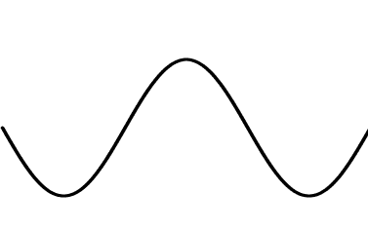
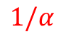
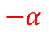
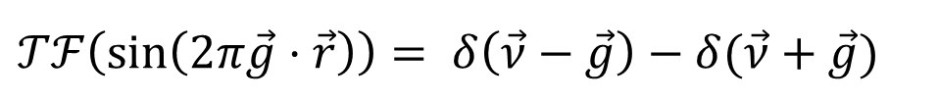

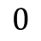

Fourier transform
$$𝒯ℱ\left(\sin\left(2παx\right)\right)= δ\left(ν−α\right)−δ(ν+α)$$
$$1/α$$
$$−α$$
$$0$$
$$0$$
$$α$$
$$𝒯ℱ\left(\sin\left(2π\vec{g}⋅\vec{r}\right)\right)= δ\left(\vec{ν}−\vec{g}\right)−δ(\vec{ν}+\vec{g})$$
Notes:
A set of two images

Slide 4
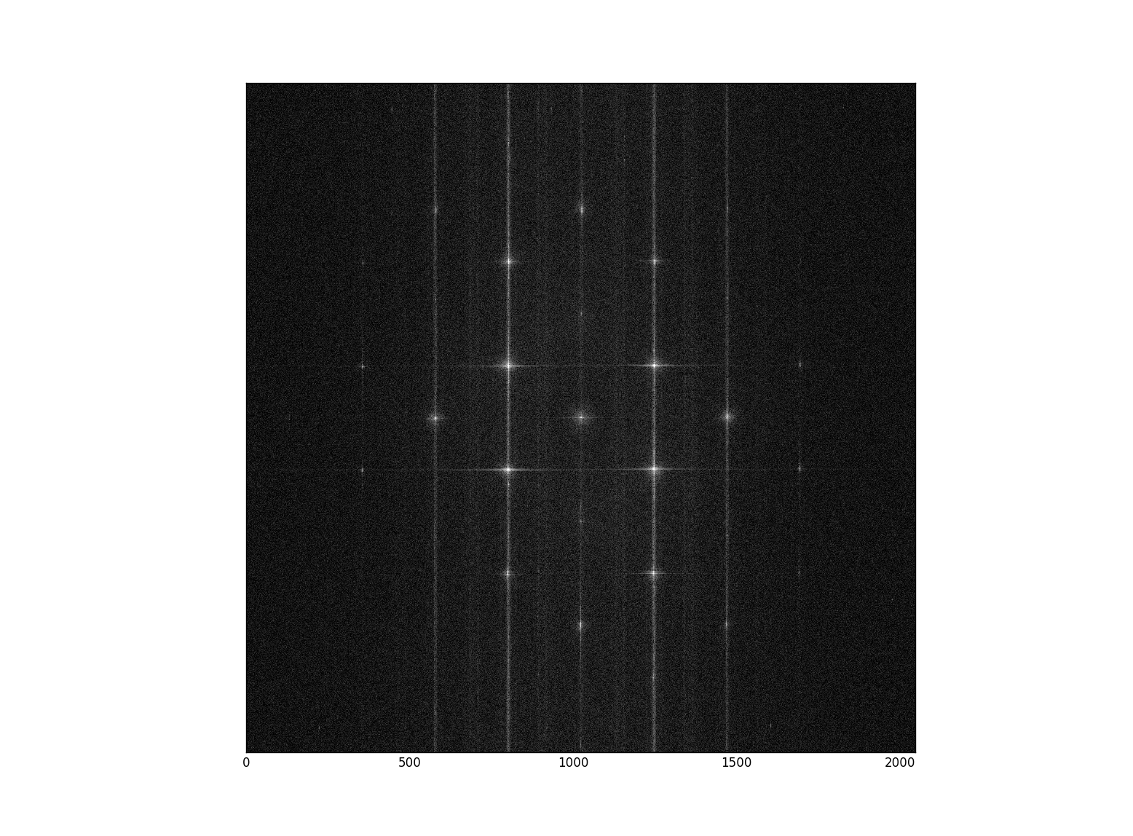
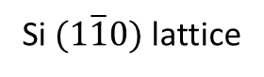
Fourier transform
High frequency
0
Low frequency
1 nm
Si $(1\overline{1}0)$ lattice
Fourier Transform (cropped)

Slide 5

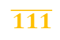

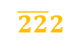




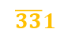

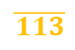


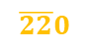


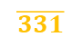


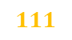
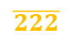
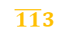
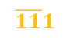
Fourier transform
$$004$$
$$\overline{11}3$$
$$113$$
$$\overline{22}2$$
$$002$$
$$222$$
$$\overline{33}1$$
$$\overline{11}1$$
$$111$$
$$331$$
$$\overline{22}0$$
$$000$$
$$220$$
$$\overline{331}$$
$$\overline{111}$$
$$11\overline{1}$$
$$33\overline{1}$$
$$00\overline{2}$$
$$22\overline{2}$$
$$\overline{222}$$
$$\overline{113}$$
$$11\overline{3}$$
$$00\overline{4}$$
1 nm
Si $(1\overline{1}0)$ lattice
Fourier Transform (cropped)

Slide 6
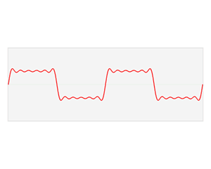
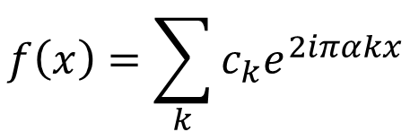
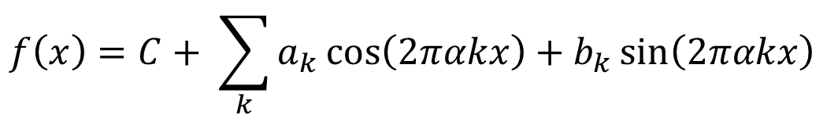
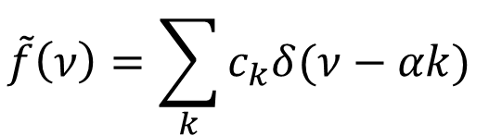
Fourier series decomposition
A function can be decomposed into a infinite series of periodic functions (cosine, sine) base
$$f\left(x\right)=C+ \sum_{k}{a_{k}\cos\left(2παkx\right)+b_{k}\sin\left(2παkx\right)}$$
$$f\left(x\right)=\sum_{k}{c_{k}e^{2iπαkx}}$$
$$\tilde{f}\left(ν\right)=\sum_{k}{c_{k}δ(ν−αk) }$$
https://en.wikipedia.org/wiki/Fourier_series#/media/File:Fourier_series_and_transform.gif

Slide 7
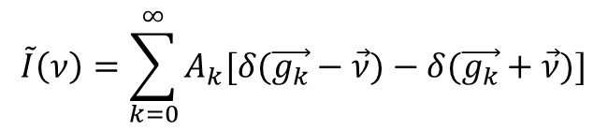
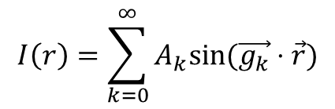
+
Fourier filtering using a set of spatial periodicities
Si lattice
+
=
+
+
+
1 nm
FT
$$I\left(r\right)=\sum_{k=0}^{∞}{A_{k}sin⁡(\vec{g_{k}}⋅\vec{r})}$$
Sparse signal in Fourier space
$$\tilde{I}\left(ν\right)=\sum_{k=0}^{∞}{A_{k}[δ(\vec{g_{k}}−\vec{ν})−δ(\vec{g_{k}}+\vec{ν})]}$$

Slide 8
Fourier filtering tutorial using Jupyter notebook

Slide 9
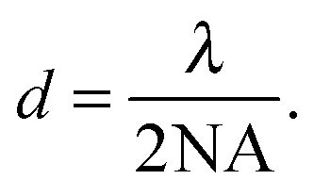
Resolution
“Optical resolution is limited by the diffraction of visible light wavefronts as they pass through the circular aperture at the rear focal plane of the objective.
As a result, the highest achievable point-to-point resolution that can be obtained with an optical microscope is governed by a fundamental set of physical laws (described by Ernst Abbe) that cannot be easily overcome by rational alternations in objective lens or aperture design. These resolution limitations are often referred to as the diffraction barrier, which restricts the ability of optical instruments to distinguish between two objects separated by a lateral distance less than approximately half the wavelength of light used to image the specimen.”

Slide 10
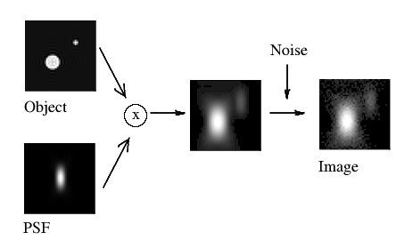
How we obtain an image at the scope
x - Convolution

Slide 11
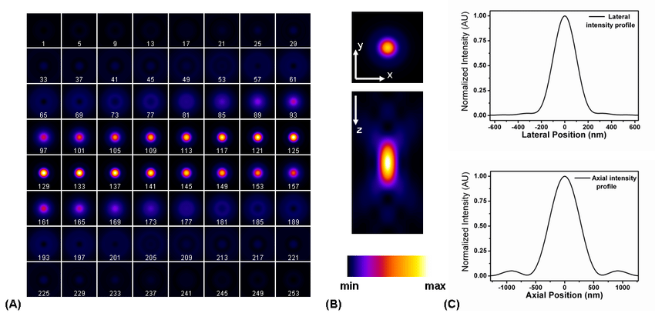
How we obtain an image at the scope
from Vicidomini, Giuseppe; “Three-Dimensional Image Restoration in Fluorescence Microscopy“ (2008)

Slide 12

Diffraction

Slide 13
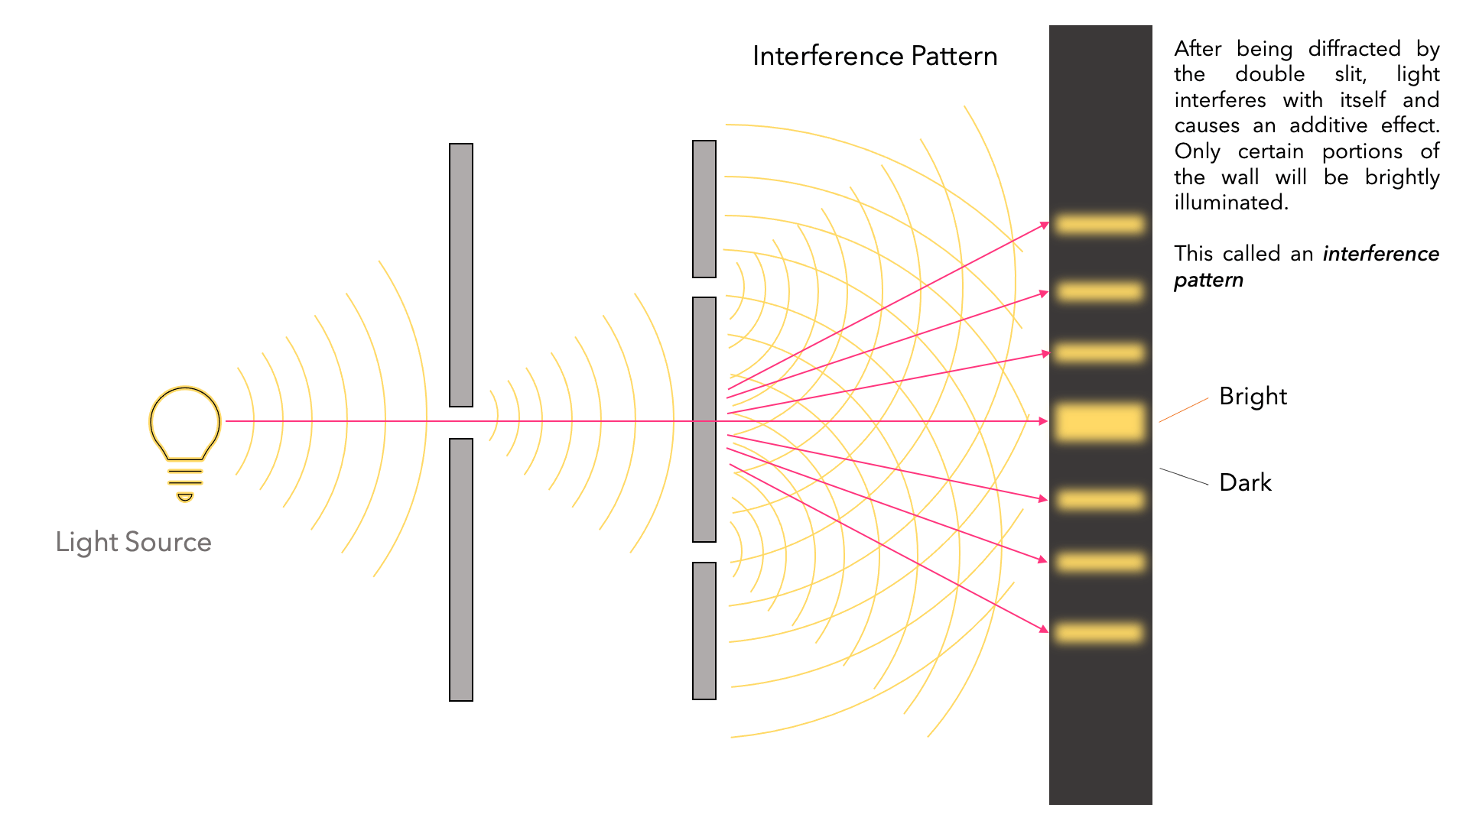
Light diffraction

Slide 14

Deconvolution
*
* - Deconvolution

Slide 15
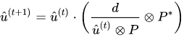
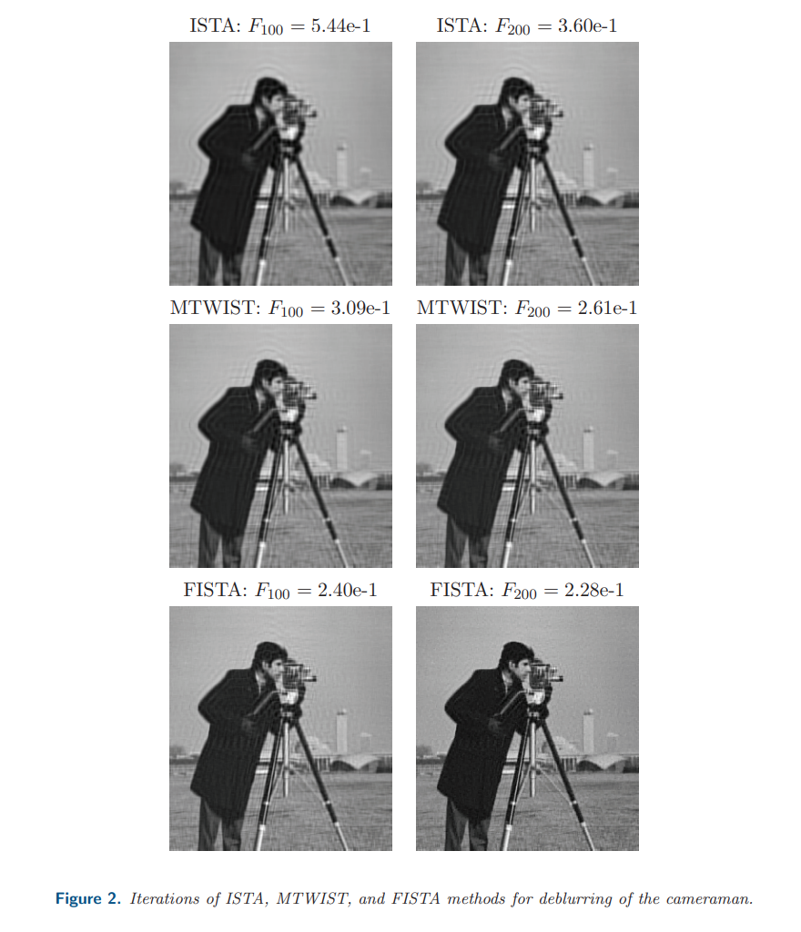
Common Algorithms
Lucy Richardson (most commonly used iterative process)
Maximum likelihood solution - where the division and multiplication are element wise, ⊗ indicates a 2D convolution, and P* is the flipped point spread function.
Deconvolution can also be done using filtered wavelet coefficients.
By computing the wavelet from the point spread function, you find a new transform algorithm and a reconstruction method related to it.
Fast Iterative Shrinkage Thresholding (FISTA) algorithm
https://www.cs.cmu.edu/afs/cs/Web/People/airg/readings/2012_02_21_a_fast_iterative_shrinkage-thresholding.pdf

Slide 16
Deconvolution tutorial using Fiji

